Slide 1
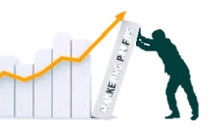
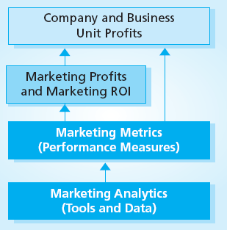
Marketing Metrics and Marketing Profitability
MBM6
Chapter 2
Tracking Marketing Performance
to Profit Performance Impact
Chapter 2 Objectives
Understand the importance of marketing metrics
Measure marketing profitability and Marketing ROI
Manage marketing profitability
How to measure and benchmark Marketing ROI and Marketing ROS
Marketing Metrics are at the core of a market-based business striving to achieve profitable growth.
Copyright Roger J. Best, 2012

Slide 2
Marketing Metrics and Marketing Profitability
MBM6
Chapter 2
Company Performance
and the Importance of Marketing Metrics
In this section we will look at financial performance and the role marketing metrics play in providing a broader view of overall company performance.
Copyright Roger J. Best, 2012

Slide 3
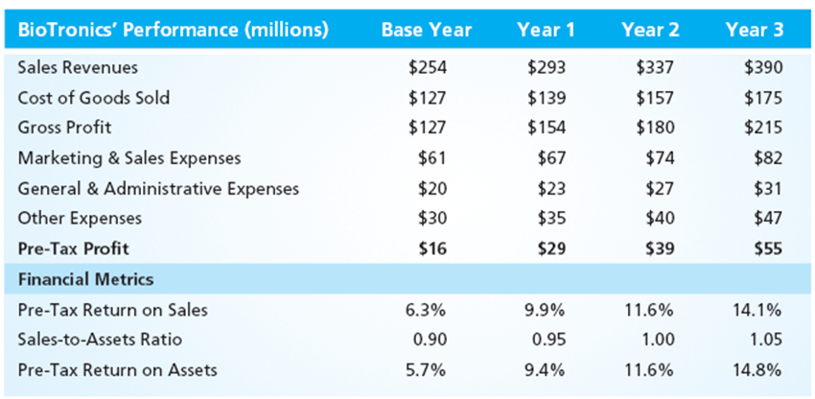
Company Performance
MBM6
Chapter 2
How would you rate this company’s performance over the last 3 years?
Good, average, or poor?
Copyright Roger J. Best, 2012

Slide 4
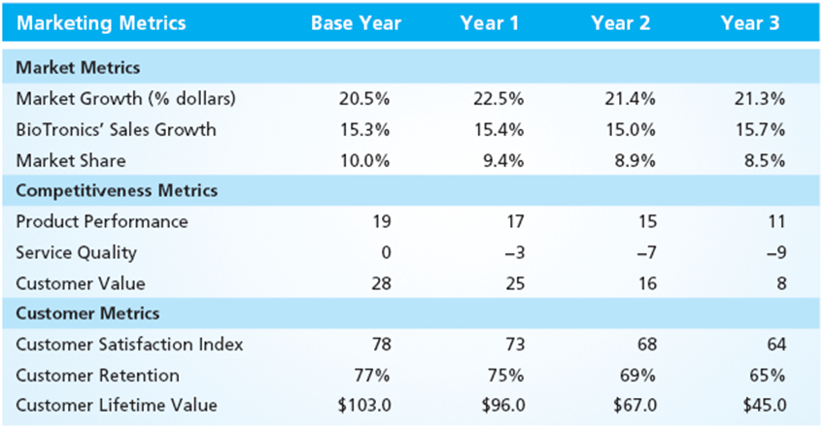
The Importance of Marketing Metrics
MBM6
Chapter 2
Marketing metrics provide a different view of company performance. How would you rate the marketing performance shown above? Good, average, or poor?
Copyright Roger J. Best, 2012

Slide 5
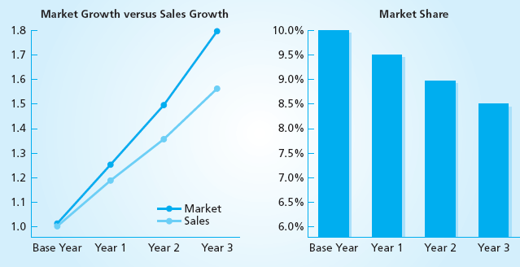
External Market Performance
MBM6
Chapter 2
The market is growing faster than company sales. This means the company is losing market share, but is likely unaware without utilizing these market metrics.
Copyright Roger J. Best, 2012

Slide 6
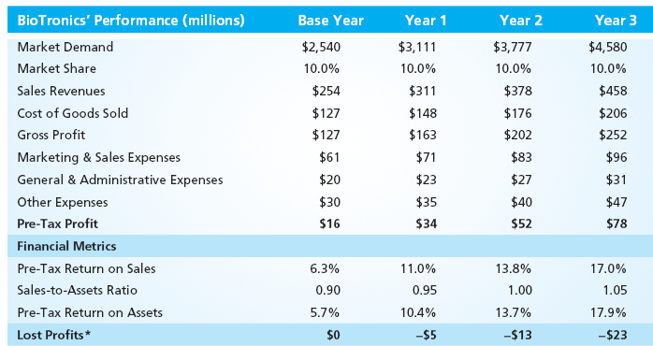
Profit Impact of a Hold Share Strategy
MBM6
Chapter 2
Managing market share to hold share in a rapidly growing market would have yielded the company $41 million in additional profits over the past 3 years.
Copyright Roger J. Best, 2012

Slide 7
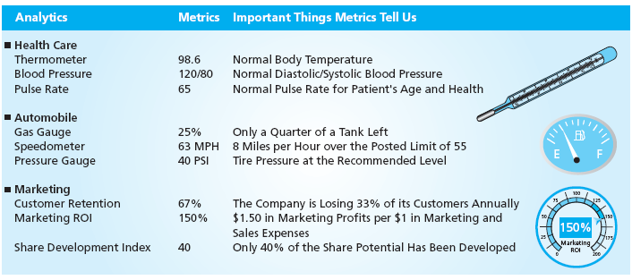
The Importance of Marketing Metrics
MBM6
Chapter 2
Analytics: The measurement devices or data used to create metrics.
Metrics: The specific measures of performance.
For Example: The measurement system used to measure customer satisfaction is a Marketing Analytic. A Customer Satisfaction Index of 72 and % Very Satisfied of 20% are Marketing Metrics.
Copyright Roger J. Best, 2012

Slide 8
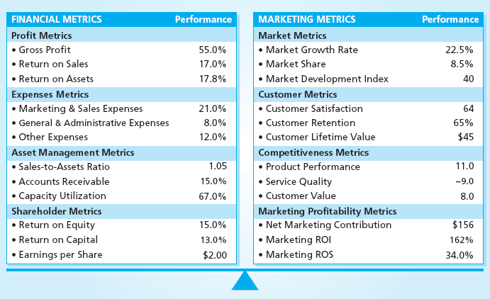
A Well-Balanced Performance Profile
MBM6
Chapter 2
Internal View of Performance
External View of Performance
Financial Metrics: These are internal performance metrics.
Marketing Metrics: These are external performance metrics.
Why are both
Important?
Copyright Roger J. Best, 2012

Slide 9
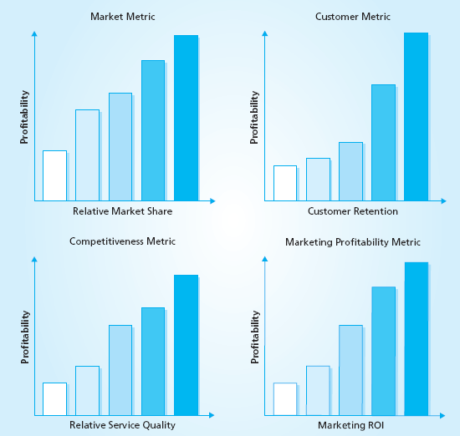
Profit Impact of Marketing Metrics
MBM6
Chapter 2
Most marketing metrics have high correlation with profitability.
Businesses that perform well on these marketing performance metrics are considerably more profitable.
Why would a business with higher relative service quality be more profitable?
Copyright Roger J. Best, 2012

Slide 10
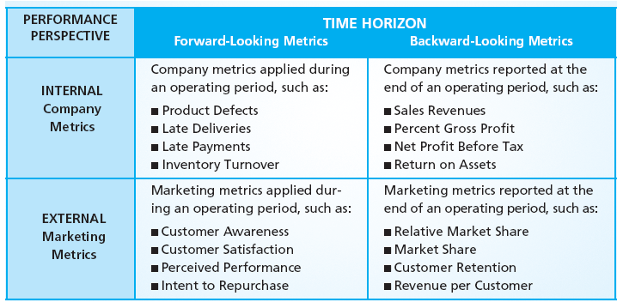
Customer Focus, Customer
MBM6
Chapter 2
Why are forward-looking performance metrics especially important?
Copyright Roger J. Best, 2012

Slide 11
Marketing Metrics and Marketing Profitability
MBM6
Chapter 2
Measuring Marketing Profitability
and Marketing ROI
In this section we will look at how to measure Marketing Profitability (NMC) and Marketing ROI.
Copyright Roger J. Best, 2012

Slide 12
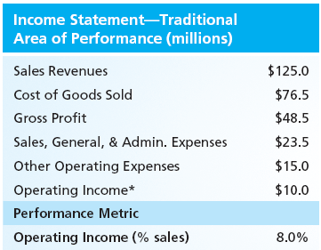
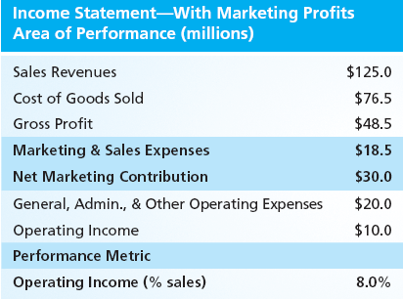
Adding Marketing Profits to Performance
MBM6
Chapter 2
Why is Net Marketing Contribution a reasonable measure of marketing profits?
Copyright Roger J. Best, 2012

Slide 13
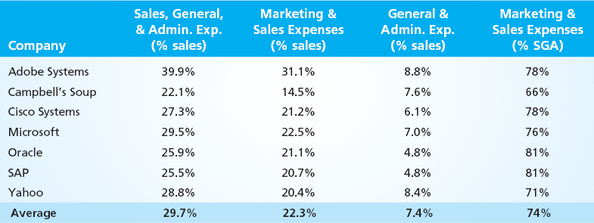
MBM6
Chapter 2
Estimating Marketing & Sales Expenses (% sales)
Data Challenge: Use 75% of SGA as an estimate of MSE
Unfortunately, most companies do not report their Marketing & Sales Expenses separately in their financial reports except for the sample of companies above. Based on the data above, we recommend using 75% of SGA as good estimate when actual marketing & sales expenses are not reported.
Copyright Roger J. Best, 2012

Slide 14
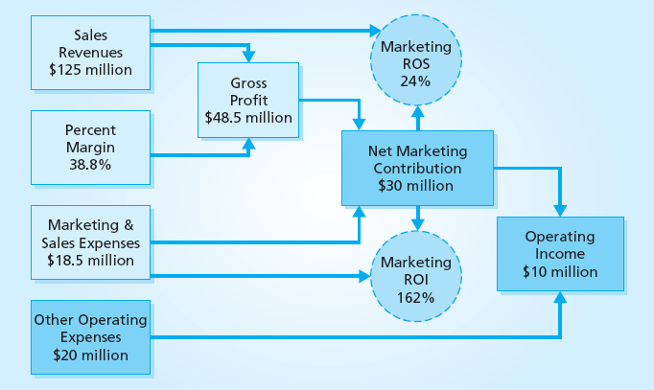
Marketing Profitability & Marketing Profitability Metrics
Marketing Performance Tool 2.3
MBM6
Chapter 2
These two marketing profitability ratio metrics allow us to compare company performance with any part of the business…regions, markets, segments, products. * Marketing Performance Tool 2.3 can be used to analyze any company
Copyright Roger J. Best, 2012

Slide 15
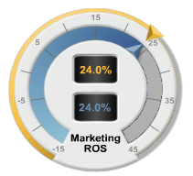
Marketing ROI and Marketing ROS
MBM6
Chapter 2
$125
$100
$75
$50
$25
$0
NMC is 24% of sales
Marketing Return on Sales (ROS)
= Net Marketing Contribution/Sales X 100%
= $30 million/ $125 million x 100%
= 24%
Sales $125 mil.
NMC $30 mil.
This marketing profitability metric tells us what portion of sales are marketing profits.
Copyright Roger J. Best, 2012

Slide 16
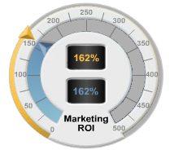
Marketing ROI and Marketing ROS
MBM6
Chapter 2
$125
$100
$75
$50
$25
$0
NMC is:
NMC = Gross - Marketing & Profit Sales Exp.
($48.5M) (*$18.5M)
Mktg. & Sales Expenses
$18.5M
Marketing Return on Investment (ROI)
= NMC/Mktg & Sales Exp. X 100%
= $30 million/ $18.5 million x 100%
= 162%
Sales
$125M
Gross Profit
$48.5M
NMC
$30M
In this case, for every $1 invested in Marketing & Sales Expenses, the company produces $1.62 in marketing profits.
Copyright Roger J. Best, 2012

Slide 17
Marketing Metrics and Marketing Profitability
MBM6
Chapter 2
Managing Marketing Profitability
In this section we will look at Santa Fe Sportswear with respect to how to use marketing profitability in marketing management
Copyright Roger J. Best, 2012

Slide 18
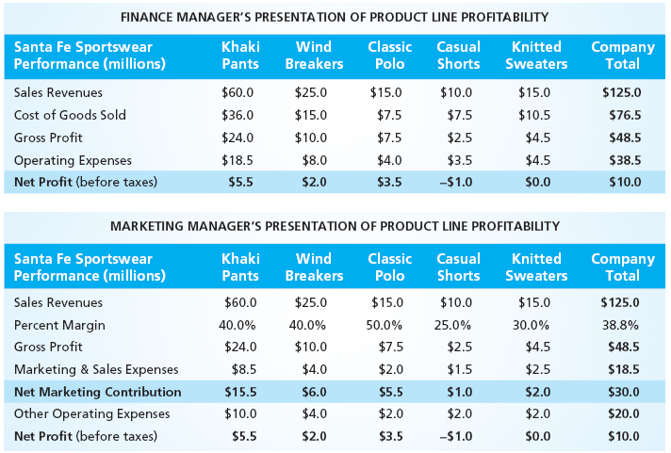
Product Line Marketing Profitability
MBM6
Chapter 2
Adding Net Marketing Contribution to this product financial statement allows marketing and product managers to better manage and communicate product line marketing profits.
Copyright Roger J. Best, 2012

Slide 19
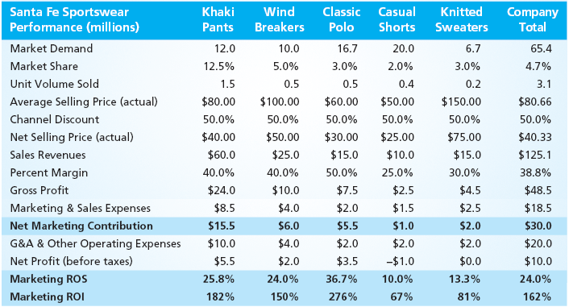
Marketing Performance Tool 2.1
Drop Casual Shorts From Product Line
MBM6
Chapter 2
Marketing Strategy: The Finance Manager wants to drop the Casual Shorts product line to improve profits! Good decision or bad decision? How should the marketing manager and product manager respond? * Marketing Performance Tool 2.1 can be used in analysis of this product line.
Copyright Roger J. Best, 2012

Slide 20
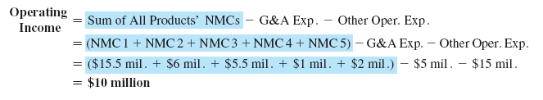

Profit Impact of Dropping Casual Shorts
MBM6
Chapter 2
Marketing Strategy: Drop the Casual Shorts product line to improve profits! Bad decision?
The Operating Income will drop by $1 million, the exact amount of the Casual Shorts NMC of $1 million. Because Gen Adm. Expenses do not have anything to do with the product lines the total remains.
Key Takeaway: As along is the NMC is positive it is contributing to profits.
Copyright Roger J. Best, 2012

Slide 21
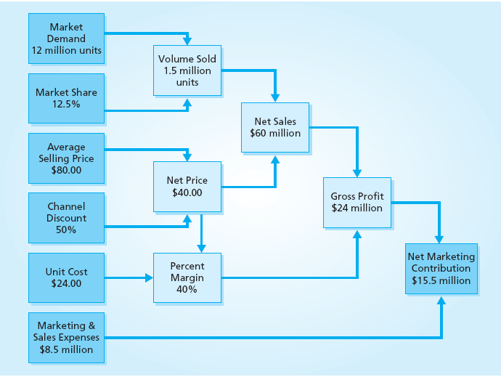
Managing the Khaki Pants Product Line Marketing Profits
MBM6
Chapter 2
A more systematic view of what drives marketing profits in the Khaki Pants product line.
Copyright Roger J. Best, 2012

Slide 22
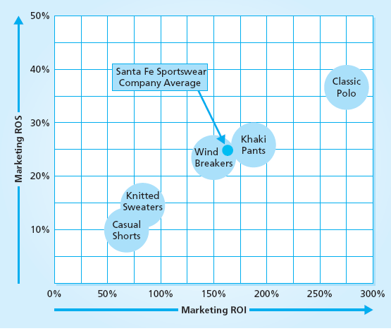
Marketing Profitability Product Portfolio
MBM6
Chapter 2
Product Portfolio
Using Marketing ROS and Marketing ROI we can create a portfolio view of product performance.
How important is the Classic Polo product line to the overall performance of Santa Fe Sportswear?
Copyright Roger J. Best, 2012

Slide 23
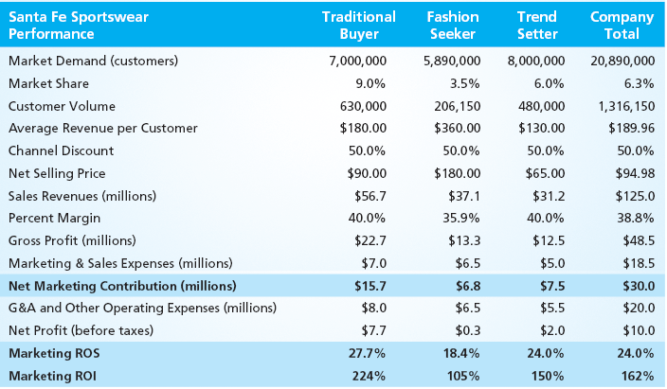
Marketing Performance Tool 2.2
Segment View of Marketing Profitability
MBM6
Chapter 2
Marketing Strategy: If Santa Fe Sports Wear had one more dollar to invest in marketing and sales expenses, where should they invest it? * Marketing Performance Tool 2.2 can be used for further analysis of this data.
Copyright Roger J. Best, 2012

Slide 24
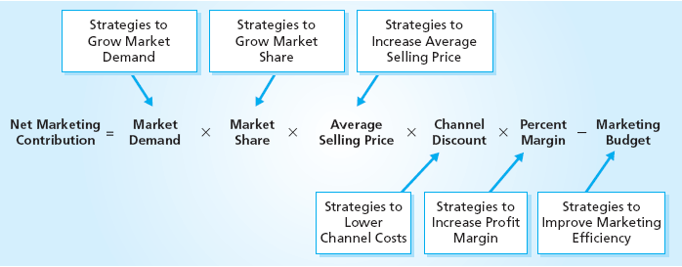
Strategies for Growing Marketing Profits
MBM6
Chapter 2
We can breakdown a measure of Net Marketing Contribution into the model above which provides marketing and product managers with strategic tools to grow marketing profits.
Copyright Roger J. Best, 2012

Slide 25

Managing the Traditional Buyer Segment
MBM6
Chapter 2
A more systematic view of what drives marketing profits in the Traditional Buyer market segment.
Copyright Roger J. Best, 2012

Slide 26
Marketing Metrics and Marketing Profitability
MBM6
Chapter 2
Benchmarking Company
Marketing ROI
and Profit Impact
In this section we will look at marketing profitability metrics with respect to competitors and a sample of Fortune 500 companies.
Copyright Roger J. Best, 2012

Slide 27
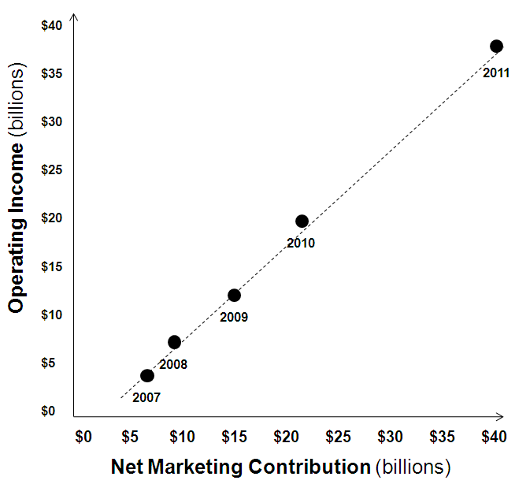
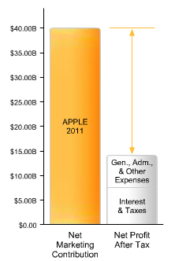
Apple NMC vs. Operating Income
MBM6
Chapter 2
Apple’s Net Marketing Contribution is very highly correlated with Operating Income.
Copyright Roger J. Best, 2012

Slide 28
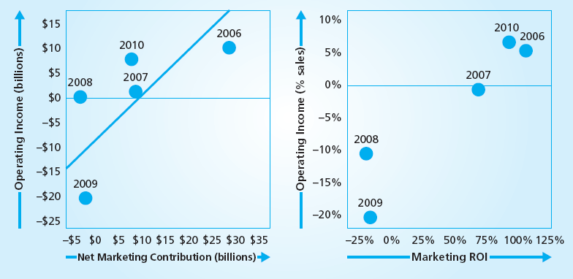
General Motors vs. Operating Income
MBM6
Chapter 2
Why is the GM Net Marketing Contribution less correlated with Operating Income?
How did Marketing ROI correspond with Operating Income as a percent of sales?
Copyright Roger J. Best, 2012

Slide 29
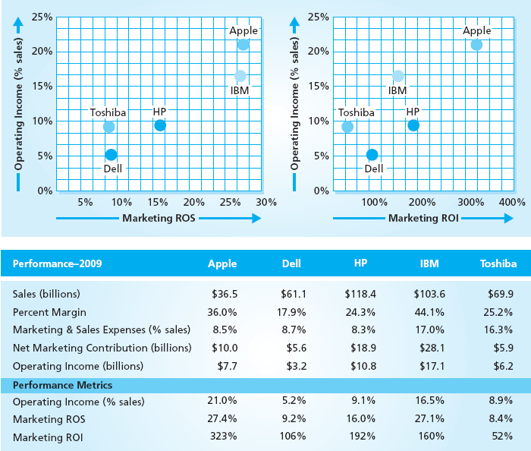
Marketing Performance Tool 2.4
Competitor Benchmarking
MBM6
Chapter 2
Competitor Benchmarking
This allows us to see Apple Performance when compared to competitors in their industry.
What is your interpretation of Dell’s marketing profitability?
* Marketing Performance Tool 2.4 can be used to analyze any five companies.
Copyright Roger J. Best, 2012

Slide 30
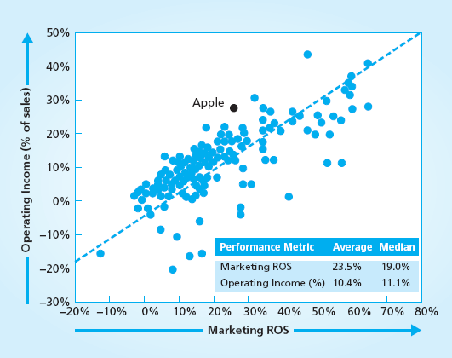
Benchmarking Apple Marketing ROI
MBM6
Chapter 2
Apple is above average in Marketing ROI but there are other Fortune 500 companies with even better performance.
Copyright Roger J. Best, 2012

Slide 31
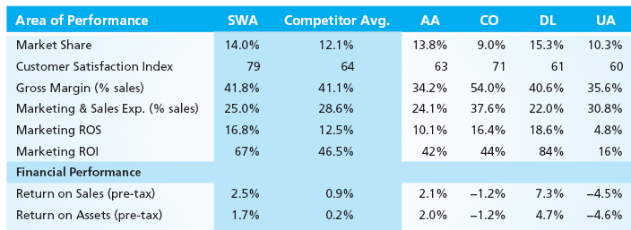
Airline Competitor Marketing Profitability
MBM6
Chapter 2
As shown above, none of the airlines do particularly well in Marketing ROS or Marketing ROI. United Airlines had the lowest customer satisfaction and Marketing ROI.
Copyright Roger J. Best, 2012

Slide 32
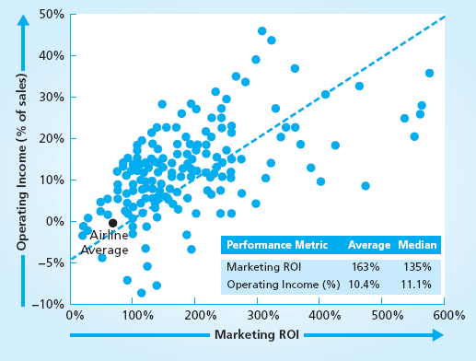
Airline Industry Marketing ROI
MBM6
Chapter 2
The Airline Industry is well below average in Marketing ROS and Marketing ROI and near the bottom when compared to other Fortune 500 companies.
Copyright Roger J. Best, 2012

